Slide 1
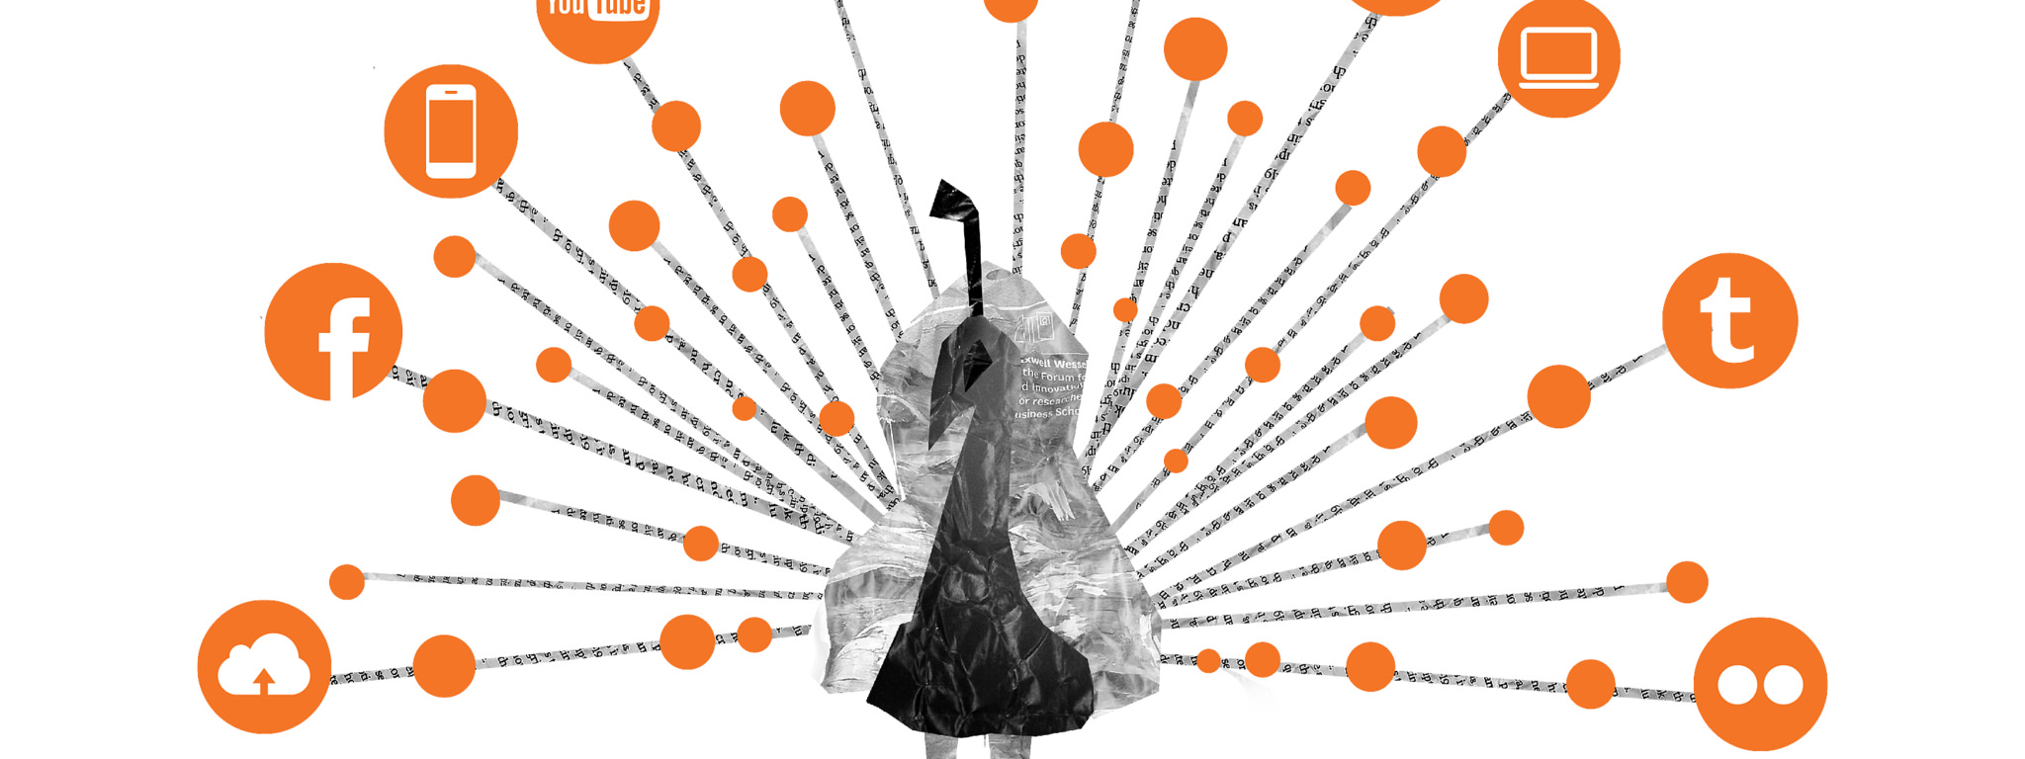
Digital Marketing
Essentials

Slide 2

Marketing and advertising
Planning and executing the conception, pricing, promotion, and distribution of ideas, goods and services that satisfy individual and organizational objectives.

Slide 3

Digital marketing channels
Owned Media
Earned Media
Paid Media

Slide 4

Marketing objectives
Segmentation
Targeting
Positioning

Slide 5
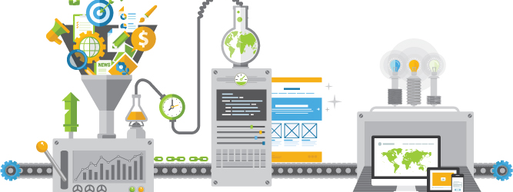
Marketing campaign lifecycle
Program vision
Stakeholder Kickoff
Creative Brief
Product / Asset Development
Programming Strategy
Launch and Performance Tracking

Slide 6
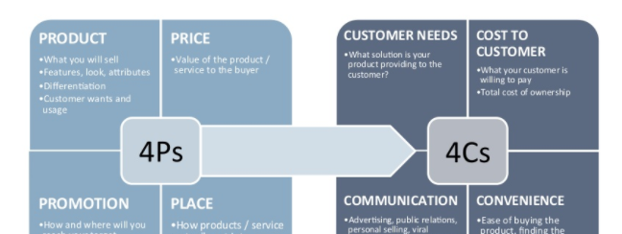
Customer centricity

Slide 7
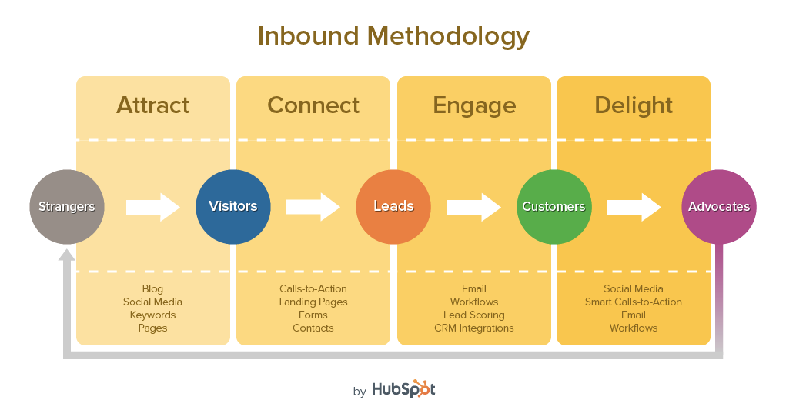
Inbound marketing
User Engagement for Conversion

Slide 8

Marketing responsibilities
Lead Generation
Engagement
Conversion
Customer Engagement
Satisfaction – Word of Mouth

Slide 9

Humans don’t want to be leads, they want relationships
Dharmesh Shah, Co-Founder and CTO HubSpot

